Slide 1



Presentation Outline
User Interface Adaptation Based on User Feedbacks and Machine Learning
Motivation
Basic concept
Bakground
Futur work
Conclusion
Nesrine MEZHOUDI
nesrine.mezhoudi@uclouvain.be
Promotor:
Prof. Jean Vanderdonckt
Jean.vanderdonckt@uclouvain.be
Louvain Interaction Lab
Université catholique de Louvain

Slide 2
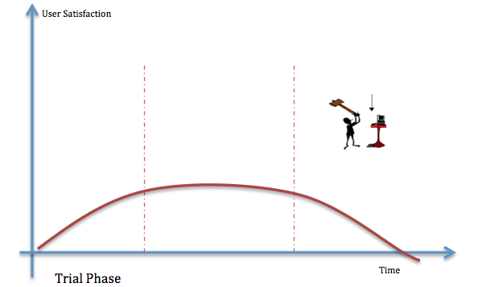
Adaptation
User-centered adaptation
Notes:
Nowadays, Context ware user interface, wish denote the UI adapted to their context of use , are holding a big interest.
given that the context of use is defined by the triplet<user, platform, environment> ; user, denoting the end user,
platform representing the device holding the user interface and the environment in wish the interaction is taking place.
currently , current systems migrate the adaptation of user interface into more user centered aspect focusing on the end user preferences
and aiming at increasing their usability as well as their user satisfaction and user experiences.

Slide 3
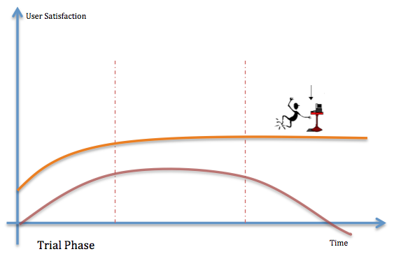
☺Adaptation
User-centeredness

Slide 4
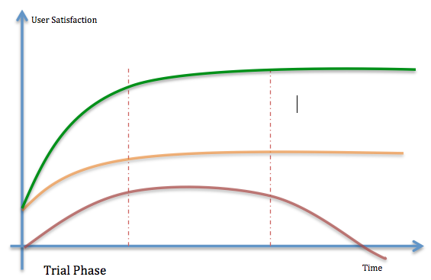
☺Adaptation
☺User-centeredness

Slide 5
Outline
Motivations
Basic concepts
Methods & Application

Slide 6
Problem: adaptation rules are static
Adaptation rules are implemented according to a predefined and static set of standards, guidelines, and recommendations
  Hardly re-adaptable
  Barely impossible to update
  Highly expensive (redevelopment, time, human resources)
Notes:
…Commonly Adaptive user interface are based on a set of predefined and even static adaptation rules defined regarding standards, ergonomic guidelines, esthetic metrics…
<<<<<<Thereby the dynamicity and the interactivity od adaptation began a crucial requirement to keep the user and ensure their satisfaction.

Slide 7
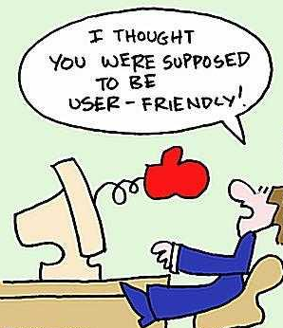
Problem: static rules prevent adaptation
Dissatisfaction
Frustration
Discouragement
Loss of motivation
…

Slide 8
Solution: involve the end-user in the user interface development
Throughout the system life-cycle
From the early stages of the system life-cycle
Starting from the user interface definition

Slide 9
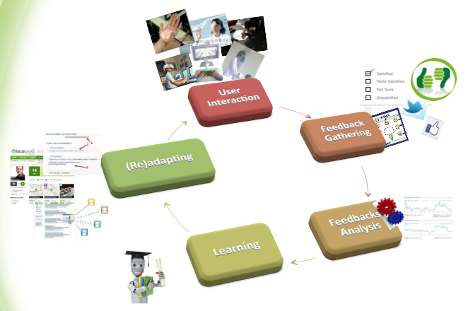

Slide 10
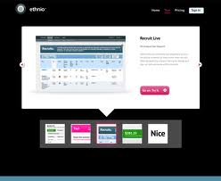
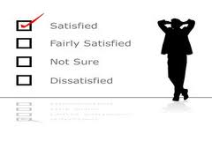
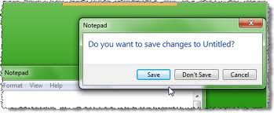
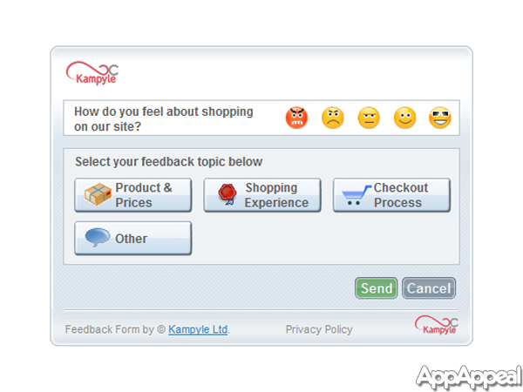
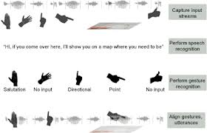
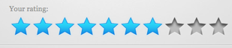



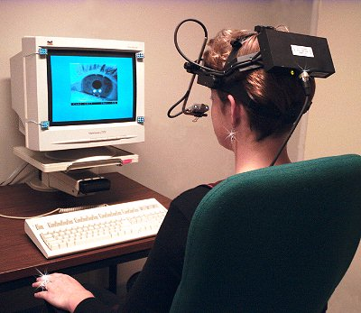
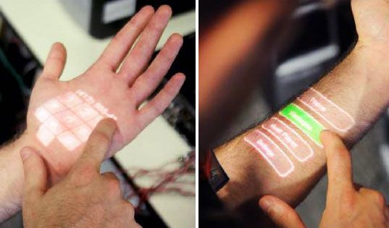
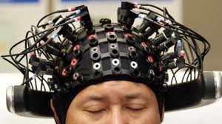
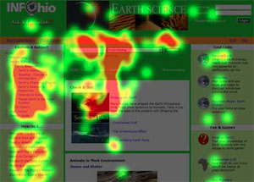
Well-rounded feedback topology
Explicit Feedback
Without rating aims
With rating aims
Implicit Feedback
10

Slide 11
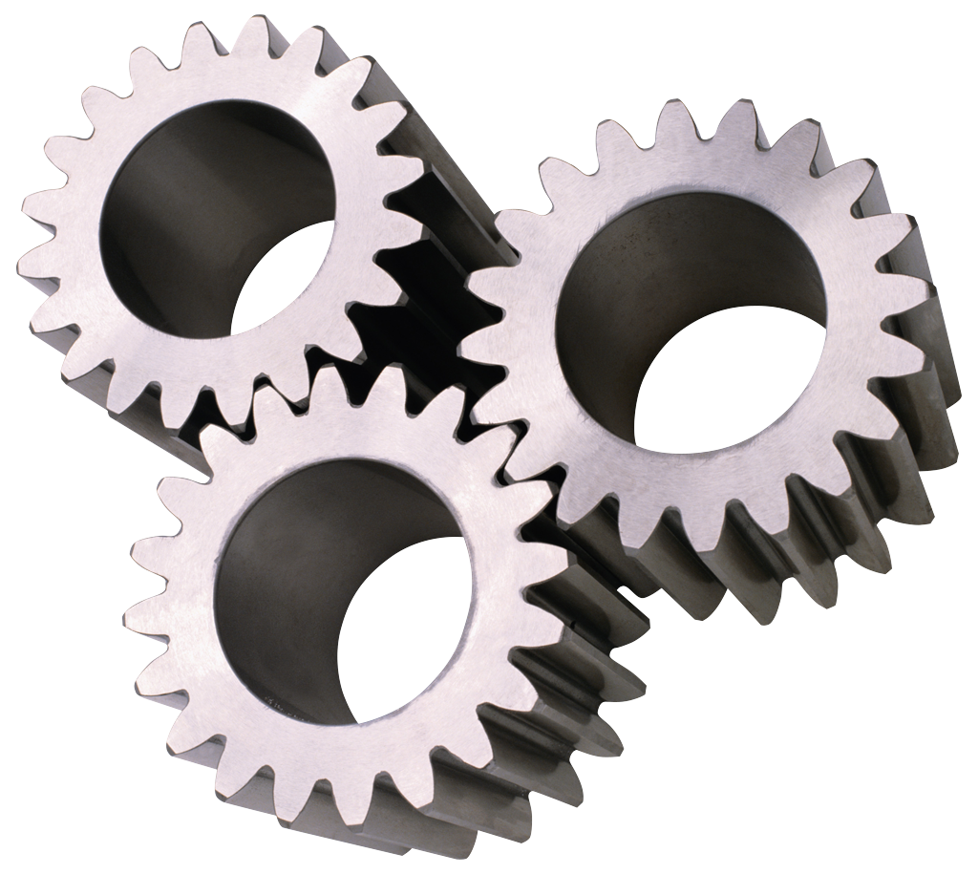

Unified theoretical architecture for adaptation based on ML
Perception Layer
Adaptation Management
Layer
User
Platform
Environment
Context
Evaluation
Perception
(tracking tools, sensors…)
Adaptation Rules
Repository
Feedback
UI
Recommendation
Updating
Reinforcement
Adapting

Slide 12

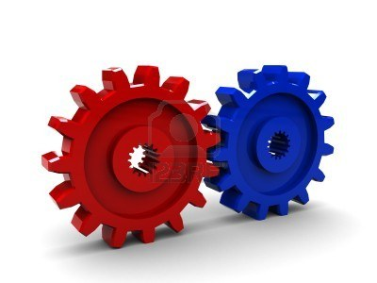
Adaptation Rule Manager
Trainer-Rule Engine
Training Rules
Feedbacks
User
Adaptation Rules
Repository
Learner-Rule Engine
Rule Management Tools
Generated Rules
Rule Engine
Notes:
The adaptation management layer is based on extraction and classification of rules and patterns
Whish are the most popular ml techniques serving as a ‘Rule learners’ , based on supervised learning approaches,
which is basically a rule management systems tools treating the users feedbacks and the set of existing adaptation rules to
generate Learns new decision rules ,
which can be added to n the adaptation rule repository after being evaluated according
to a promoting demoting techniques which give to the rule manager a new dimension of self improving learning capabilities.

Slide 13
Adaptation Rule Manager
Trainer-Rule Engine
Training Rules
Feedbacks
User
Adaptation Rules
Repository
Learner-Rule Engine
Rule Management Tools
(1) Executing pre-existed adaptation rules, serving as a training set to (2) detect a pattern of user behavior throughout his feedbacks. Besides, (3) coming up with statistics and (promote/demote) ranking for the Learner Rule Engine (RLE).
Generated Rules
Rule Engine
Notes:
The adaptation management layer is based on extraction and classification of rules and patterns
Whish are the most popular ml techniques serving as a ‘Rule learners’ , based on supervised learning approaches,
which is basically a rule management systems tools treating the users feedbacks and the set of existing adaptation rules to
generate Learns new decision rules ,
which can be added to n the adaptation rule repository after being evaluated according
to a promoting demoting techniques which give to the rule manager a new dimension of self improving learning capabilities.

Slide 14
Adaptation Rule Manager
Trainer-Rule Engine
Training Rules
Feedbacks
User
Adaptation Rules
Repository
Learner-Rule Engine
Rule Management Tools
Generated Rules
analyzing collected user judgments. Which are intended to serve in a promoting/demoting ranking, Then
generate new decision rules ,
(Learns)
Rule Engine

Slide 15
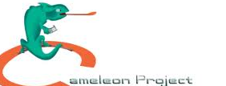
Potential applications
AUI
CUI
Final UI
Tasks
Notes:
The second aims of this research is to avail adaptation based on learning for model based user interfaces , and basically in different levels of UI generation according to the CAMELEON reference framework
]. The focus of this point is to capitalize on learning based adaptation to improve the validity of the Abstract User Interface.
Since , EVEN THAT Several algorithms were defined for the AUI definition however a lack of validity and consistency control still arise .
Moreover, an intended reward of ML technique’s potential to be envisaged for the concrete user interfaces
. Although some ML techniques were already explored , ML is consistently promising to emphasize new scenarios for
the adaptation in the concrete UI level, for instance for the widget selection ML techniques seems great to manage all adaptation rules and guideline.

Slide 16
Potential applications
AUI
CUI
Final UI
Tasks
Notes:
Moreover, an intended reward of ML technique’s potential to be envisaged for the concrete user interfaces
. Although some ML techniques were already explored , ML is consistently promising to emphasize new scenarios for
the adaptation in the concrete UI level, for instance for the widget selection ML techniques seems great to manage all adaptation rules and guideline.

Slide 17



Time-line
State of the arts
Conceptualization
Implantation
Test & Evaluation
Notes:
Tracabilityy

Slide 18


Thank you for your attention
Nesrine Mezhoudi nesrine.mezhoudi@uclouvain.be

